Slide 1
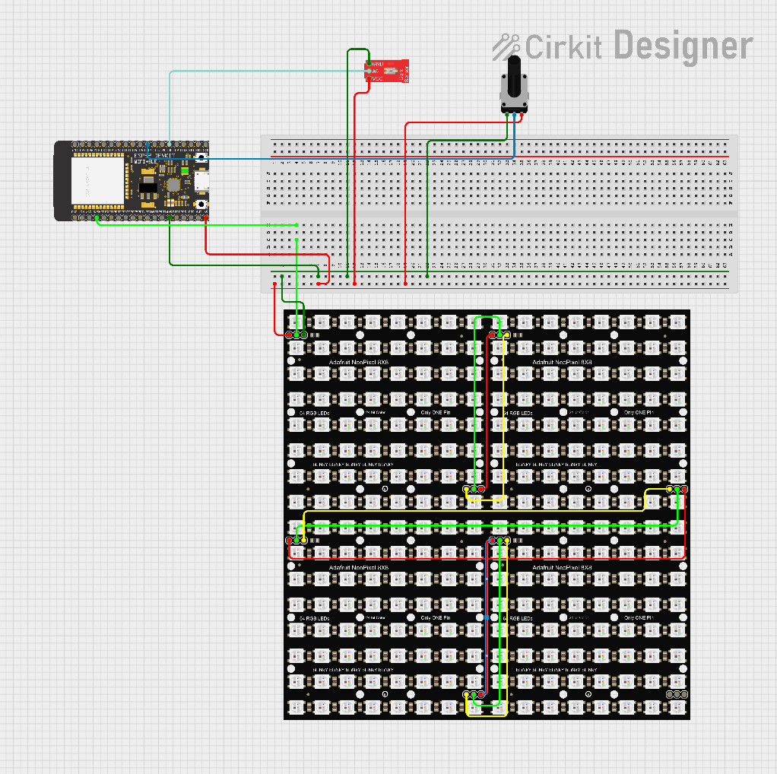
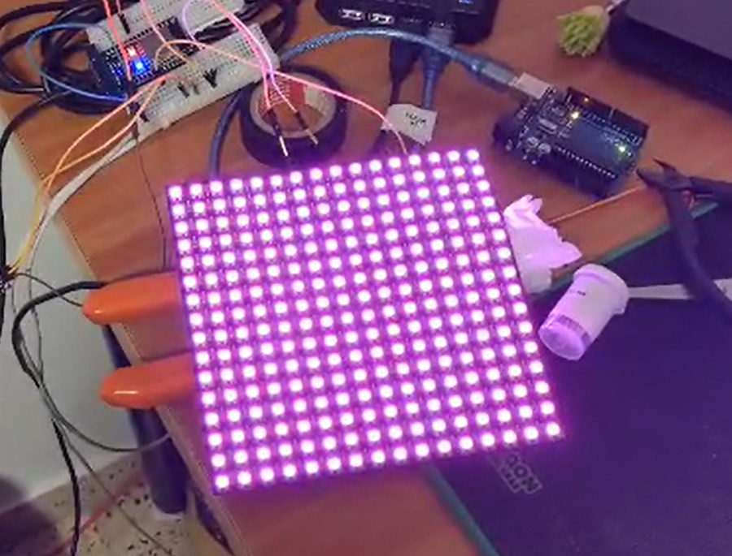
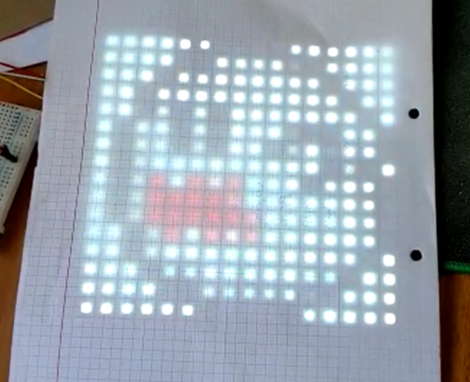
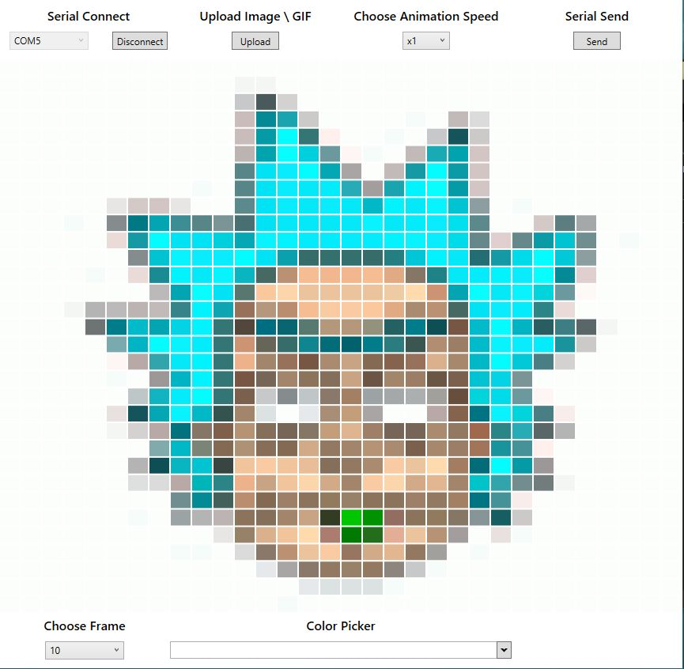
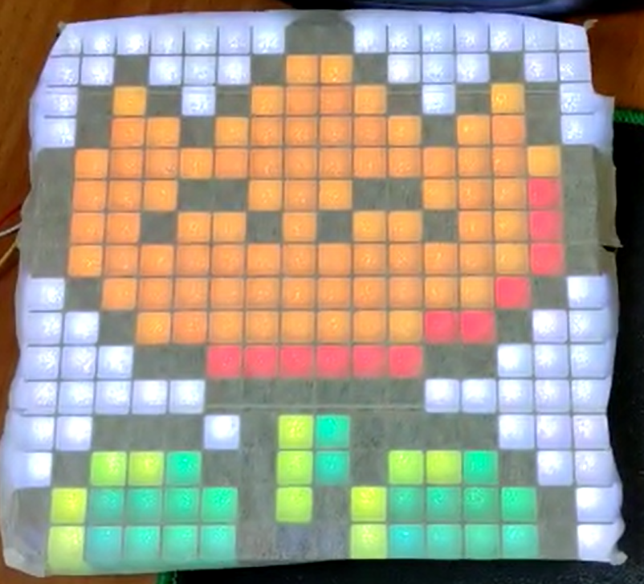
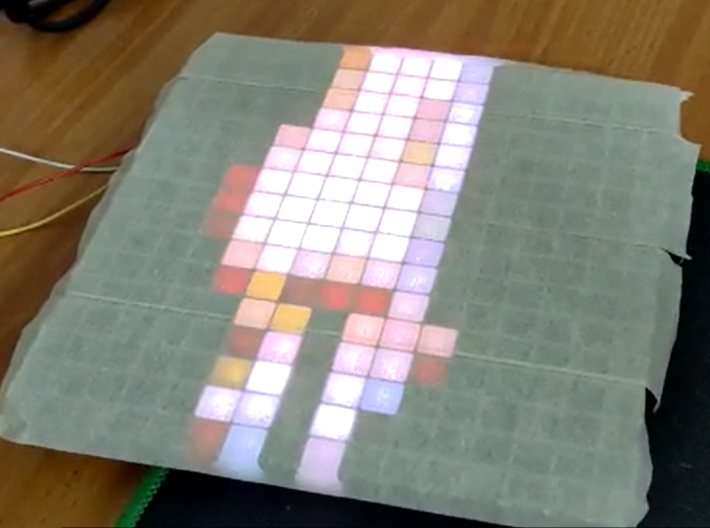
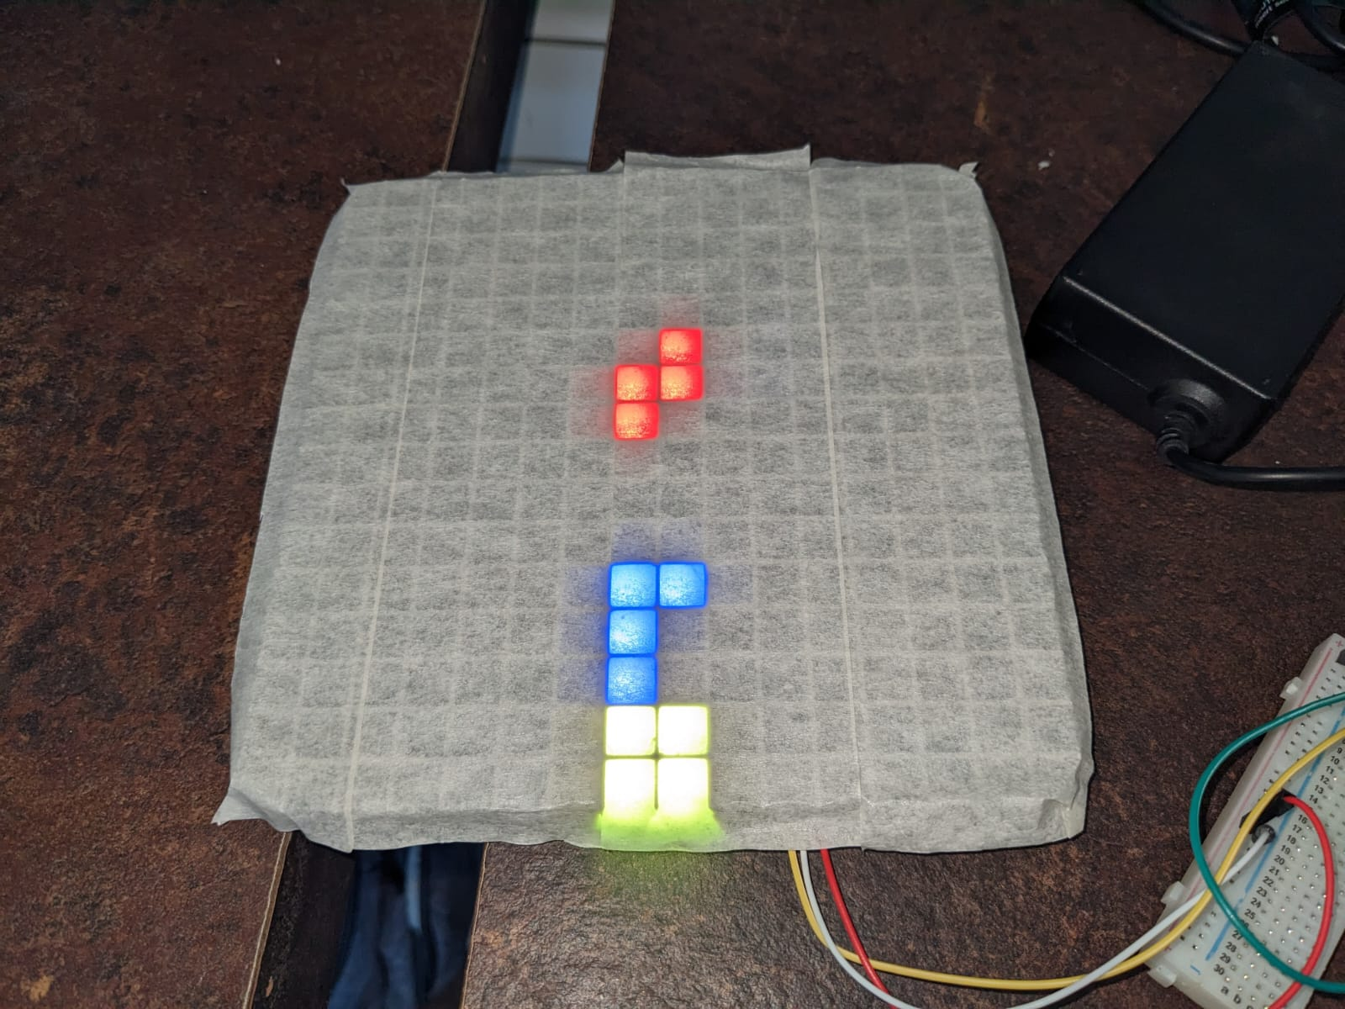
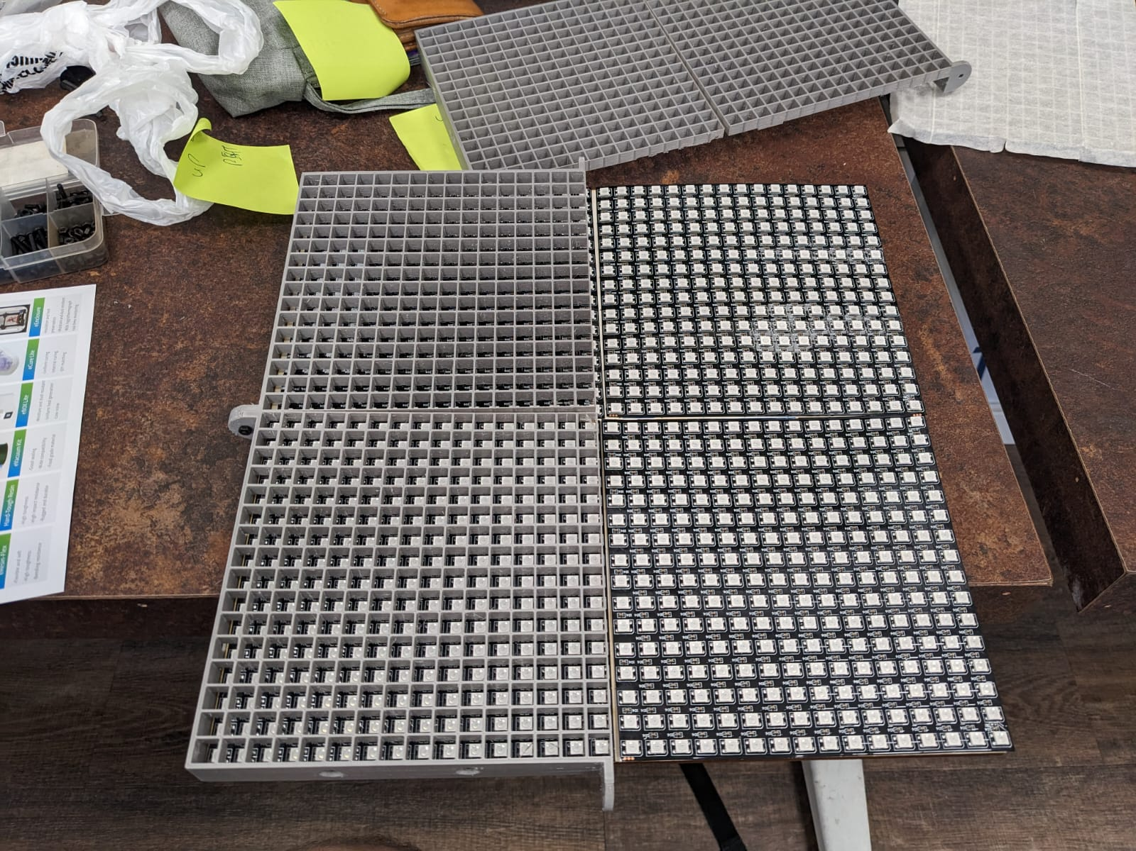
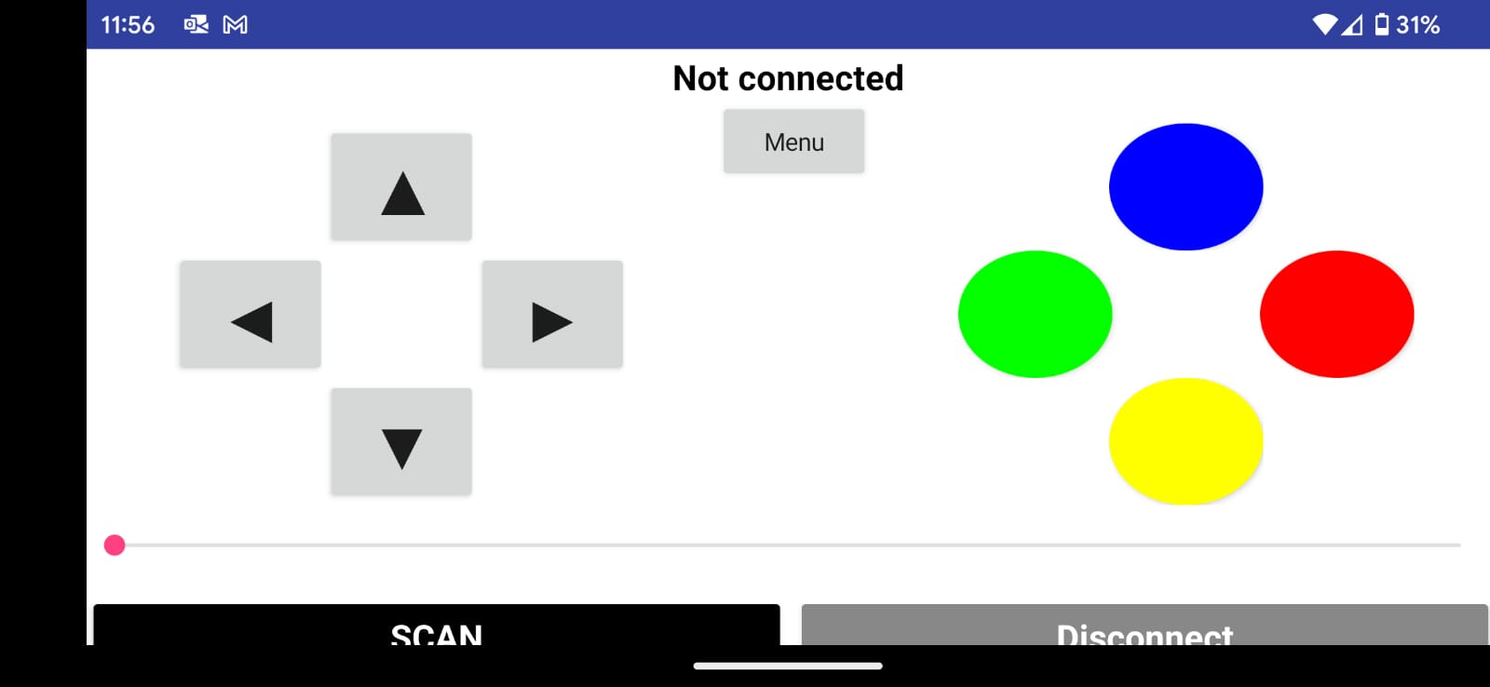
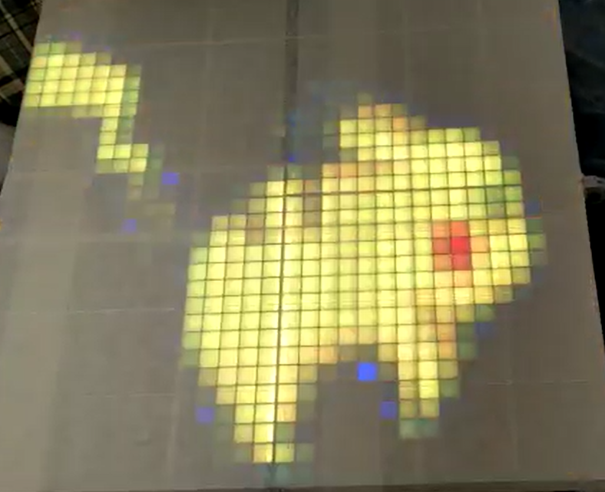
GIF Lamp
tagline - Short teaser describing main advantage or function of your project. SHORT - UP TO 6 WORDS MAX. For example - "delivers the drink right to you!" , "learn programming basics without a computer" , "control your air conditioner remotely" , etc.
User controllable smart LED light matrices with various modes.
Animations/Images previewing and uploading using windows application.
Retro games playing using a mobile app using Bluetooth.
Our Path
Coloring a single 16x16 Matrix
First Image Show
Final Circuit
After Assembling the new diffuser
First Not Hard-Coded Animation
Windows Application GUI
Allowing to preview the animations frame by frame.
Gives the option to create user made images/animation, as well as writing desired text on the matrix LED.
First Tetris Game
Assembling the 32x32 Matrix
Android Mobile Game Controller
Connects to the ESP32 using Bluetooth.
Changing modes and controlling in game mode.
First animation on 32x32 Matrix
Evgeny Lambord, Aviel Cohen, Daniel Elgarici
Lecturer: Itay Dabran
Instructors: Tom Sofer, Gilad Shmerlan

Slide 2

GIF Lamp
tagline - Short teaser describing main advantage or function of your project. SHORT - UP TO 6 WORDS MAX. For example - "delivers the drink right to you!" , "learn programming basics without a computer" , "control your air conditioner remotely" , etc.
<Project tagline - optional>
<Project description - font #54 minimum, in English only >
includes:
The need or problem your project addresses -one sentence (optional)
What you project is - in one sentence (“a locker controlled using a smart lending management app”)
What are the main features of the project (up to 3)
What makes this project unique in comparison with similar projects/products in this field (optional)
photos and graphics –
About 6 images , with description under each image ---- in #36 font
Wiring Diagram (up to date - using these tools)
App or GUI screenshot/s (real or mockup) – 1-2 images
Physical prototype photo/s – 1-2 images
Process diagram or other diagram (optional)
Do not include images downloaded from the internet, they may be copyrighted! Use only original material or images downloaded from sites with “free license” images such as FreePik.com
Evgeny Lambord, Aviel Cohen, Daniel Elgarici
Itay Dabran, Tom Sofer, Gilad Shmerlan

